Slide 1
Introduction to Robotics: Electronics Principles
Adam Watts
Engineering Physicist
Accelerator Division, Summer 2021

Slide 2
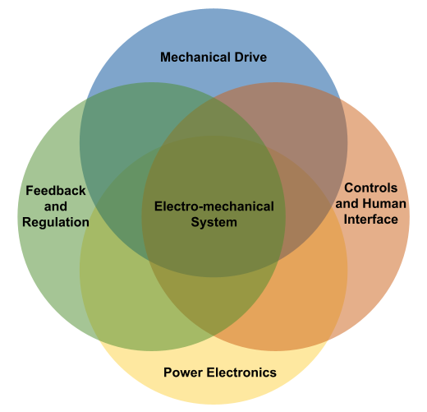
Robotics and Mechatronics
More than the sum of its parts, electromechanical systems are a multi-disciplinary application of several related fields.
The related engineering discipline is known as ``Mechatronics’’, coined in 1971 to describe the field that combines electrical, electronic, mechanical, computer, and systems control engineering.
Electromechanical systems rely on electrical power systems rather than hydraulic, pneumatic, or internal combustion. Electromechanical systems are the focus of this talk.
Robotics is a sub-field of mechatronics, dealing with general-purpose systems that can be re-programmed or automated to perform complex tasks.

Slide 3
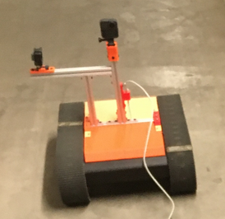
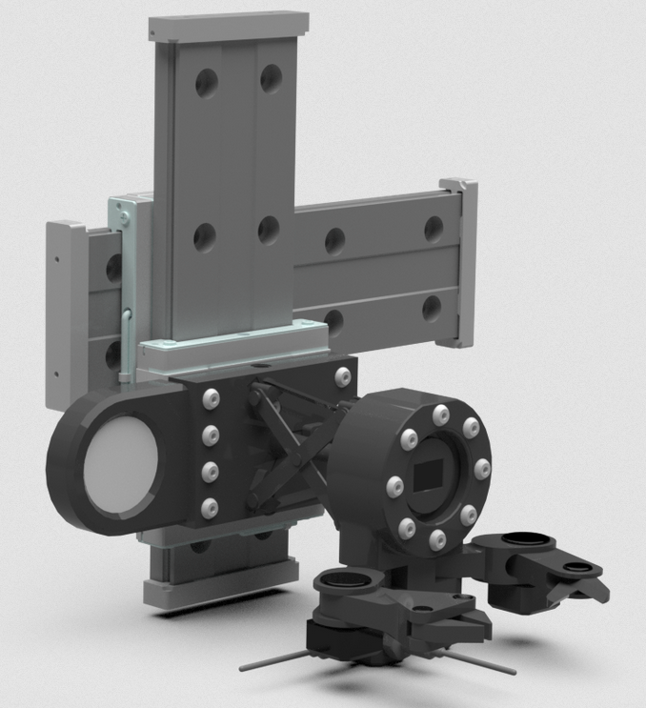
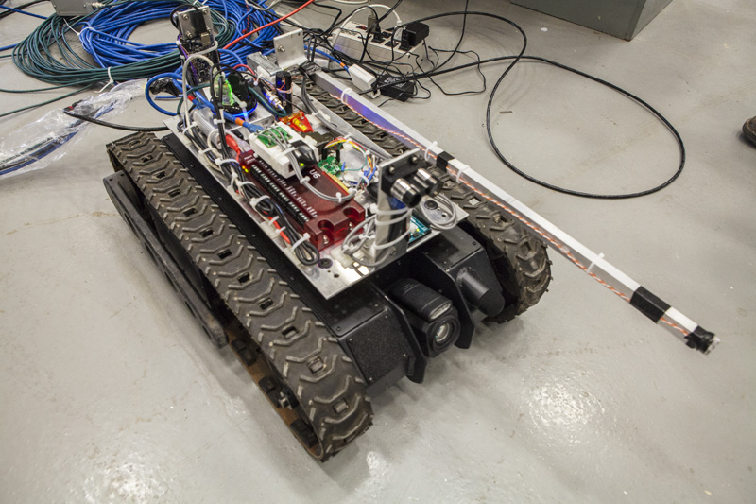
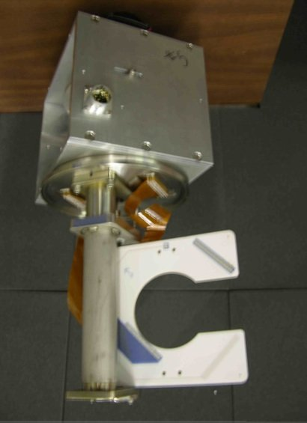

Mechatronics and particle accelerators
Mechatronic systems are useful in the operation of particle accelerators:
Automate tedious tasks
Job-site setup
Ordering/sorting material
Radiation survey
Inspection
Perform tasks that are too dangerous or difficult for humans
Tasks in high-radiation, oxygen deficient, confined space, or other hazardous areas**
Tasks that require very precise movements and tooling
Tasks that put humans at risk of injury due to heavy lifting or repetitive stress
Tasks in areas too small or convoluted for humans to fit
Allow systems to move in/out of beam path during operation of accelerator
Positioning of movable instrumentation such as multi-wire detectors
Precise motion control of collimators, beam-stops, beam-splitting septa
** See Argonaut project, robotics in liquid Argon!
Fermilab Robotics Initiative https://ad.fnal.gov/robotics/

Slide 4
Analog Electronics Principles

Slide 5
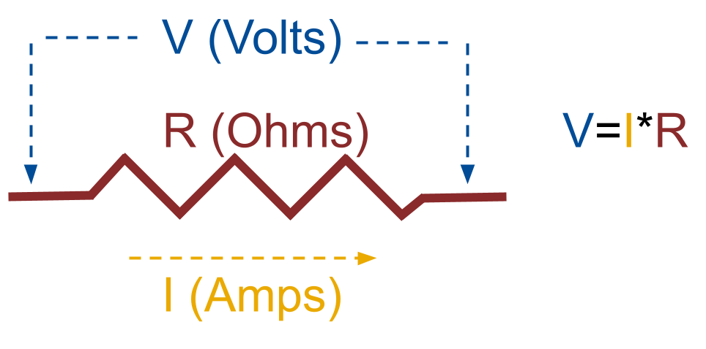
Voltage, Current, Resistance, and Power
Current (I) is the rate of electric charge passing through an electrical conductor, i.e. dQ/dt, where Q is the charge in Coulombs. The units of current are most commonly “Amperes”, or simply “Amps” for short, which are equivalent to “Coulombs per second”.
Voltage (V) is the amount of potential energy available to push electrical current, and is most commonly measured in units of “Volts”. Voltage is always described as a difference in potential between two points. One point may be considered “ground”, i.e. a reference of zero volts. For this reason, we specify “voltage to ground”, or the voltage “across” some element; this is also known as the ``voltage drop’’ across that component.
Resistance (R) is a material’s natural tendency to prevent electrical current from flowing freely; in other words, resistive materials are imperfect conductors.
Most simple materials have a linear relationship between voltage and current, with the resistance being the slop of that line. This relationship is expressed as V=I*R, known as “Ohm’s Law”.
Electrical power ``P’’ for unchanging current and voltage is measured in units of Watts, and is simply the voltage multiplied by the current.
Electricity with constant voltage and current is ``DC’’, or ``Direct Current’’. For time-varying voltage and current, it’s known as ``AC’’ or ``Alternating Current’’.

Slide 6
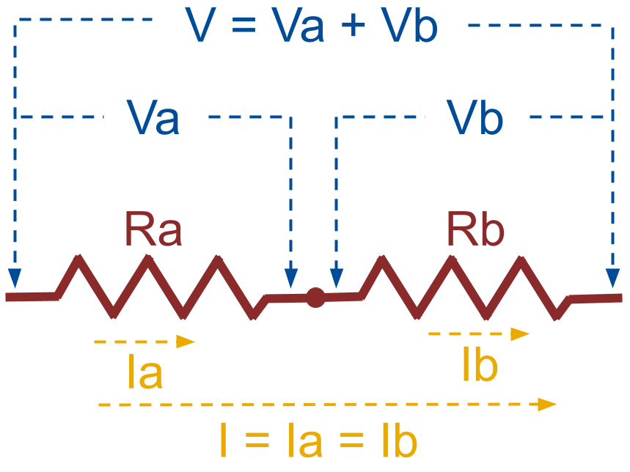
Series resistors
Series electrical connections combine two elements one after the other, with the voltage first dropping across one component then the other. Below is an example of two resistors in series, and the voltage drop across both resistors in total is the sum of their individual voltage drops. However, the same current passes through both resistors.
Combining the above voltage and current relationships of series resistors with Ohm’s Law, it becomes clear that the total resistance is just the sum of both resistances. In other words, resistors add in series.
Ohm’s Law for total circuit
Total voltage drop is sum of individual drops
Ohm’s Law to convert Va=Ia*Ra, Vb=Ib*Rb
Substitute Ia=Ib=I
Therefore,

Slide 7
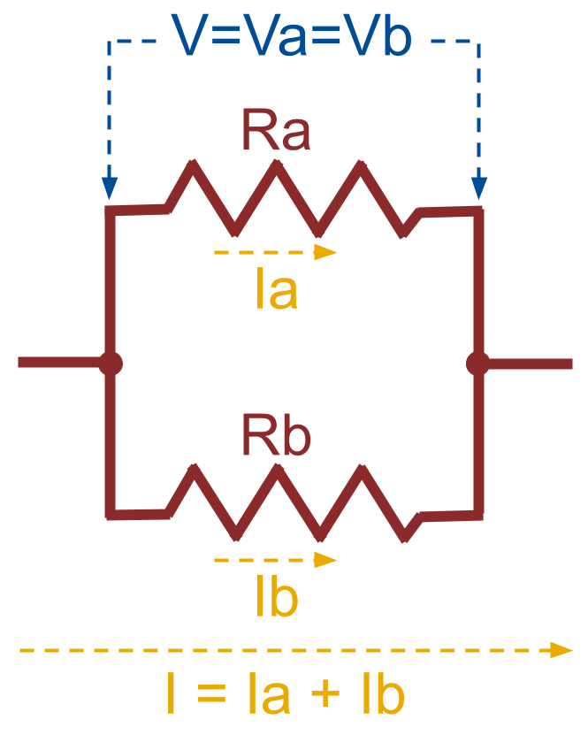
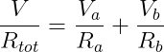
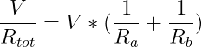
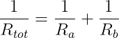
Parallel resistors
Parallel electrical connections have elements with current flowing simultaneously through each. This means that the voltage drop across each element in parallel is identical, and the total current is the sum of all simultaneous parallel currents.
Using these relationships and Ohm’s law, it turns out that parallel resistors add reciprocally.
Expression for the total current
Use Ohm’s law to rewrite in terms of voltage drops
Since both voltage drops are equal in parallel,
Therefore,

Slide 8
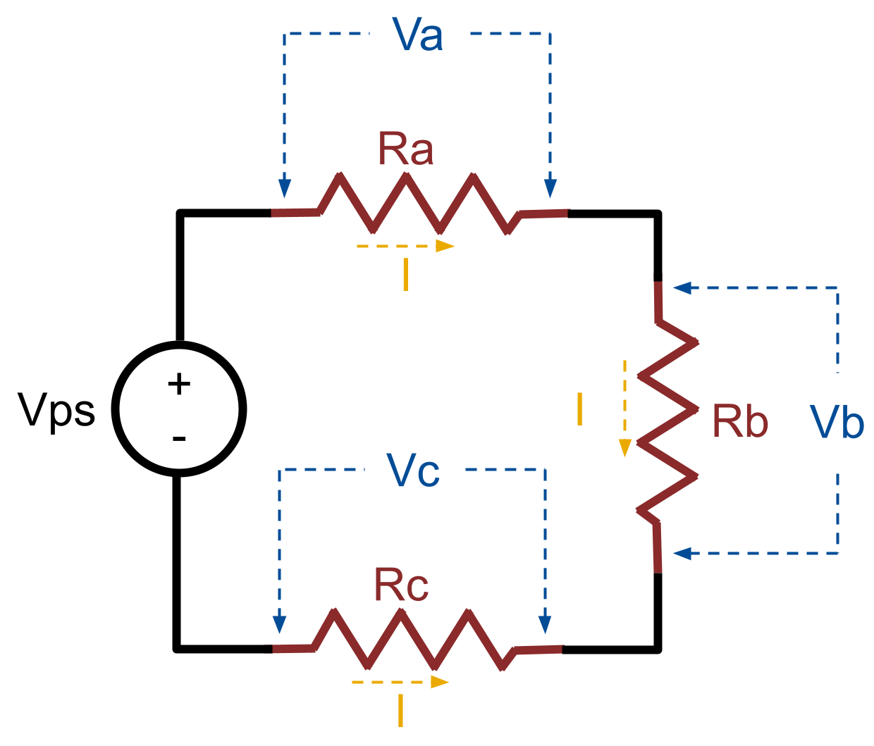
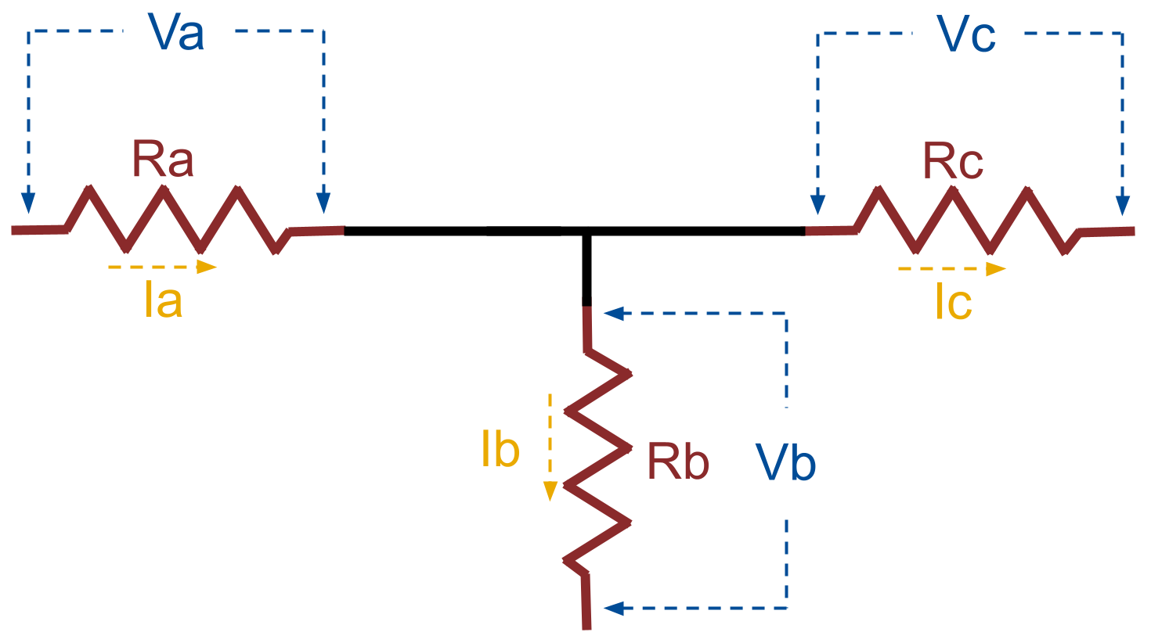
Kirchoff’s Laws
Two important laws for ”solving” circuits, i.e. calculating all unknowns (Vps is a constant-voltage power supply):
Kirchoff’s Voltage Law
The sum of all voltage drops in a circuit loop are equal to zero.
Kirchoff’s Current Law
The sum of all currents entering a circuit node must be equal to the sum of all currents leaving that node (charge is conserved, neither created nor destroyed).

Slide 9
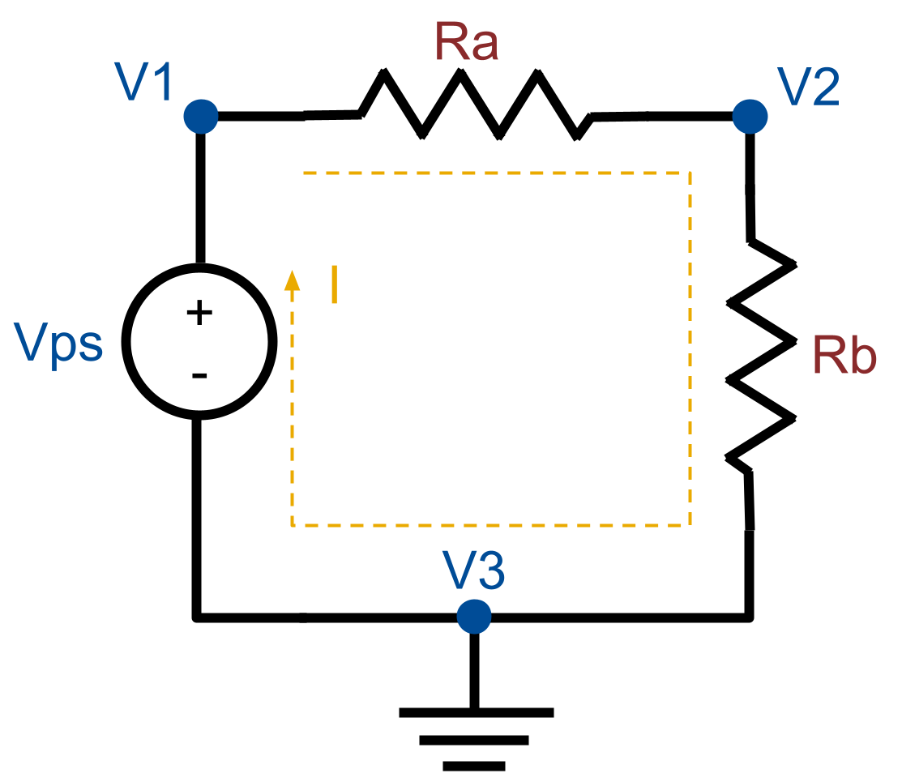
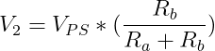
Circuit-solving example: the voltage divider
General procedure for circuit-solving:
Identify all unique-voltage nodes, labeled in this circuit as V1, V2, and V3.
Identify all unique current loops. In this case, there is a single current loop labeled “I”.
Apply any of Kirchoff’s two laws and Ohm’s law to generate a linear system.
Solve the system for all remaining unknown voltages and currents. To constrain the system enough to solve, one node may need to be chosen as the reference zero potential, or “ground”. Note any node can be chosen; in this case, we’ve chosen node 3.
Exercise: Show that solving this circuit yields the following.
(Hint, Va = V2-V1, Vps = V1-0, and Vb = 0-V2.)
Known as a “voltage divider” circuit, this converts a power supply voltage to another voltage by choosing the value of the two resistors. For example, if Ra = Rb, the output voltage V2 is half the power supply voltage.

Slide 10
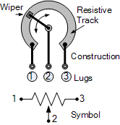
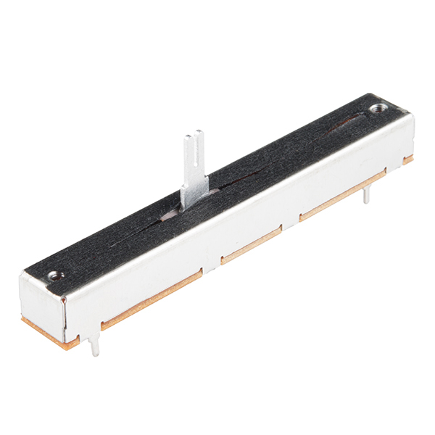
Potentiometers
Potentiometers, often referred to as ”pots”, are three-terminal manually-adjustable resistor dividers. The ratio of the divider is proportional to the angular position of the adjustable knob, which moves the position of the “wiper” inside the device.
Common rotational pots are useful for electrical adjustments, but also as feedback sensors in mechatronics, since they can measure precise angular displacements if properly calibrated.
Potentiometers can also be linear sliders, capable of precise measurement of linear position.
Knob and slide potentiometers can have either a linear or logarithmic change in divider ratio as a function of wiper position.
Source: https://www.electronics-tutorials.ws/resistor/potentiometer.html
Source: https://www.sparkfun.com/products/9119

Slide 11
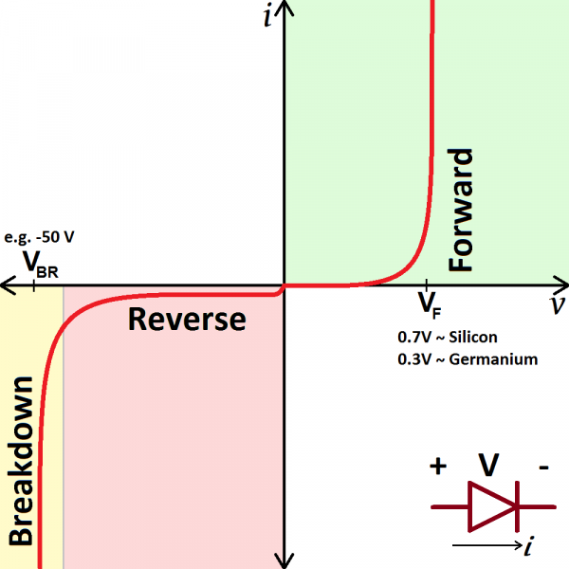
Non-linear elements: Diodes
The diode is an electrical circuit component that conducts current with very little resistance if the voltage across it is high enough to achieve “forward bias”.
If the voltage drop across the diode is reversed, the diode will eventually conduct current backwards, but this “reverse bias” voltage is much higher than the forward bias.
The diode acts as a one-way conductor, only allowing reverse current if the backwards voltage drop is extremely high.
(Note: What would the curve for a resistor look like on the pictured chart?)
Source: https://learn.sparkfun.com/tutorials/diodes/all

Slide 12
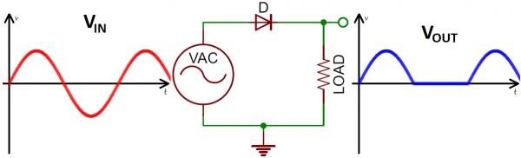
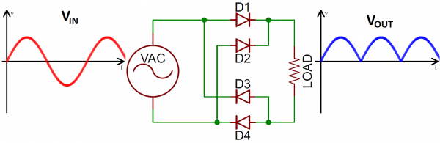
Diode rectifiers
One common use for the basic diode is the “rectifier”, which converts an AC voltage into a fully-positive rippled voltage. With proper filtering (in a few slides), this can convert AC to DC voltage.
A “half-wave” rectifier consists of a single diode in series with the resistive load. The diode only conducts when Vin is forward-biased, and does not conduct for the rest of the input sinusoid.
With the right arrangement of four simple diodes, the output voltage across the resistive load is the absolute value of the input voltage. This is a “full-wave” rectifier.
Source: https://learn.sparkfun.com/tutorials/diodes/all

Slide 13
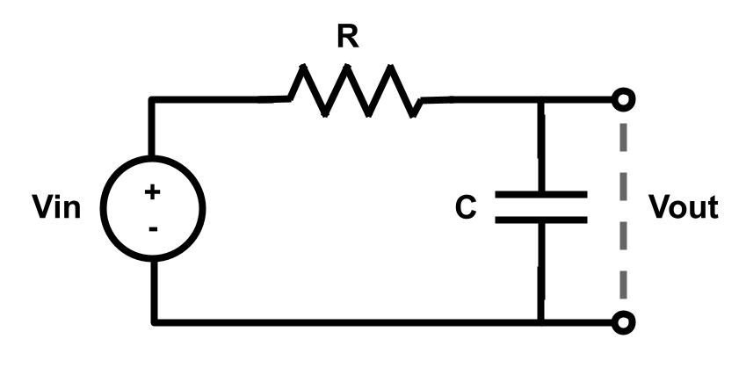
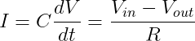
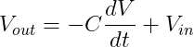
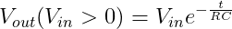
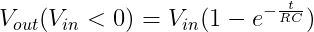
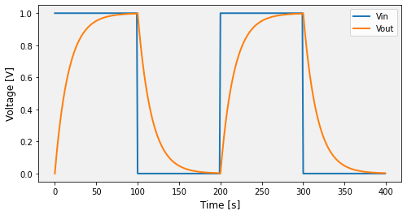
Capacitors: time domain
Capacitors come in many types, some of which whose polarity cannot be reversed (i.e. electrolytic capacitors). Regardless, all capacitors store energy by creating an electric field between two electrodes
Fundamentally, the current through a capacitor proportional to the voltage rate of change by the capacitance (units of “Farads”). The simple circuit below shows the voltage across a capacitor when charged and discharged through a resistor by turning the power supply voltage on and off.
Using Ohm’s law and the capacitor current relationship, we can write a differential equation that describes the output voltage of this circuit (i.e. across the capacitor) as a function of the power supply input voltage.
The solution to the differential equation depends on whether Vin is positive or zero, and the solution shows how the capacitor voltage increases or decreases exponentially as it charges/discharges. The resistance multiplied by the capacitance is known as the characteristic “time constant” of the circuit.
Note that a capacitor by itself will conduct no DC current, because dV/dt = 0 at DC. Thus capacitors can be placed in series with a signal to “block” its DC offset (“high-pass filter”).

Slide 14
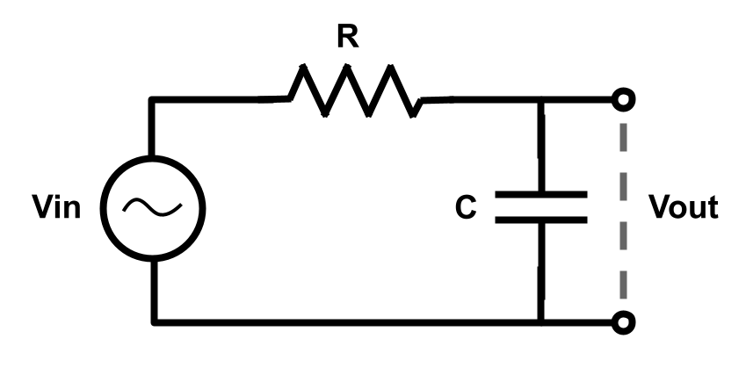
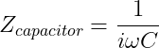
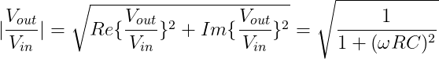
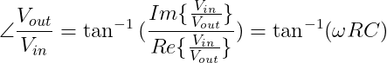
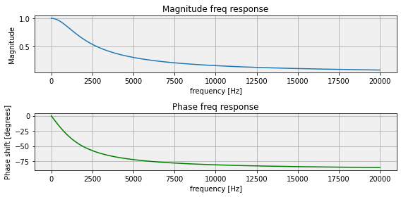
Capacitors: frequency domain
Another way to think about time-dependent electrical circuits is in the frequency domain. Assume Vin is some steady sinusoidal oscillating voltage, and consider how the circuit behaves for different frequencies. In this interpretation, a capacitor is a resistor whose value changes with frequency.
This more general expression of resistance is known as “impedance” (Z), and can be expressed as a complex number: the real part of the complex impedance represents energy dissipation (“resistance”), and the imaginary is a time-delay term from energy being stored and released (“reactance”). A perfect capacitor doesn’t dissipate power like a resistor, but stores and releases it by charging and discharging.
Treat the complex impedance like a resistor and use the same Kirchoff and Ohm laws to solve the circuit in the frequency domain. The circuit response, Vout/Vin, now has a magnitude and phase component. The circuit attenuates and delays (phase shifts) the input voltage depending on its frequency.
This circuit example acts as a “low-pass filter”.

Slide 15
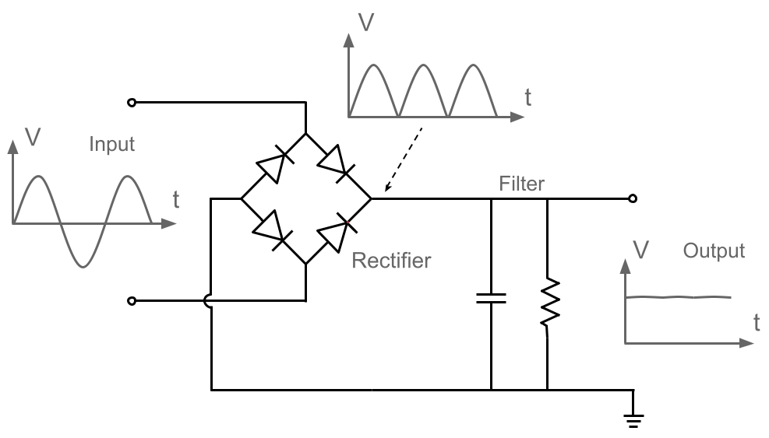
Putting it together: AC/DC conversion
The full-wave rectifier diode circuit from earlier slides can be be combined with a ”low-pass” parallel resistor-capacitor filter to significantly reduce the ripple, completing the conversion from AC to DC. This is a common circuit for DC power supplies that plug into the 120 VAC wall outlet, though they also typically include a transformer or buck converter circuit to step down the voltage before rectifying/filtering.

Slide 16
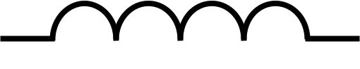
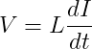
Inductors
Any loop of current creates a magnetic field (see Ampere’s Law, one of Maxwell’s Equations of electromagnetism). This tendency for current to store energy in a magnetic field is known as “inductance”, analogous to the way that charged plated store energy in an electric field (“capacitance”). An electrical component can be deliberately created with a coil of wire, and is known as an “inductor”; note also that all circuits have inherent inductance (and capacitance), though in the absence of large coils of wire the inductance is minimal for low-frequency electronics.
Important for our mechatronic applications, electric motors necessarily have high inductance due to their reliance on coils of wire to create the magnetic fields that spin the rotor. The voltage across an inductor is proportional to the rate of change of current, and the proportionality is the “inductance” L.
Consider an inductive load like an electric motor; this equation illustrates that there will be a voltage induced across the motor winding if the current is rapidly changed. In general, inductive loads smooth out changes in current much like capacitors smooth out changes in voltage. However, inductors “kick back” a voltage spike (also called “back EMF”) to resist the change in current, and this must be safely accounted for when rapidly switching motor current (i.e. with PWM control).

Slide 17
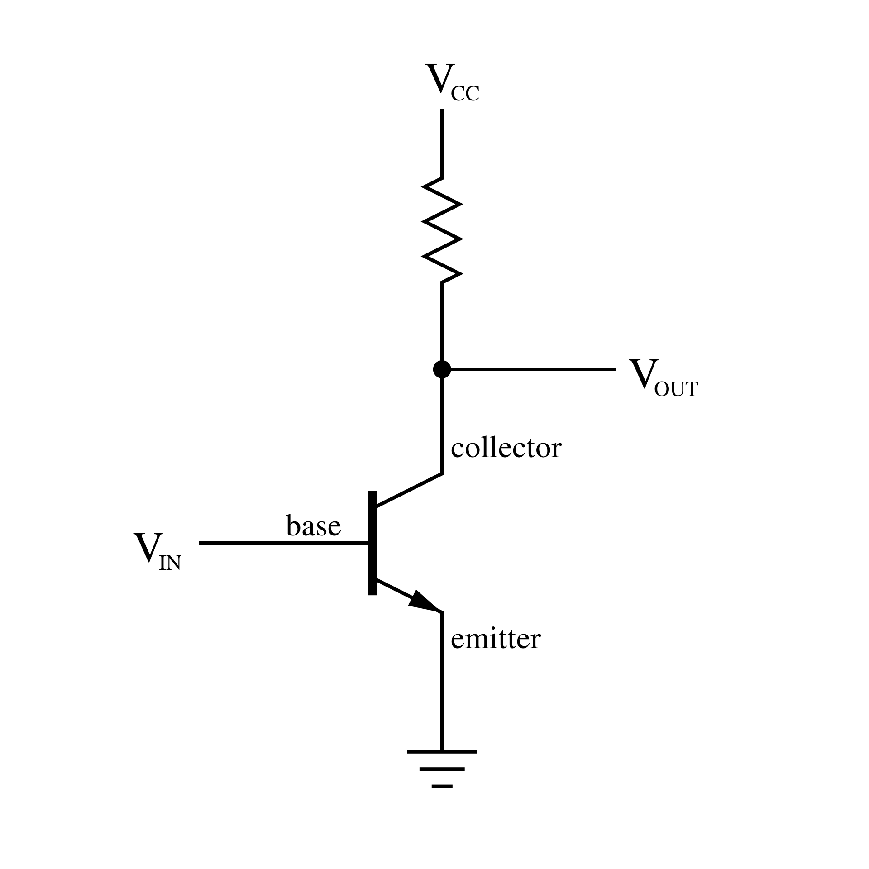
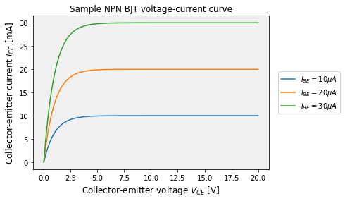
Non-linear elements: Transistors
Another important non-linear electrical component is the transistor. A simple circuit involving an “NPN” bipolar-junction transistor (“BJT”) is shown to the left, which is just one example of a transistor type.
The transistor conducts large current when its base conducts relatively small current; therefore, a transistor can act as an amplifier. However, this quasi-linear behavior between voltage and current (similar to a resistor) rolls off to a flat response at large voltages. This is known as “saturation”, where the transistor acts more as a switch.
Some transistors are purpose-made for use as switches, such as MOSFET (metal-oxide semiconductor field-effect transistors) or IGBTs (isolated-gate bipolar transistors).
Combine enough transistors together as simple digital switches (either conducting or not conducting), and one can start to build logical circuits and processors. In fact, the transistor is the building block of modern processors; the processor in your cell phone contains billions of transistors.

Slide 18
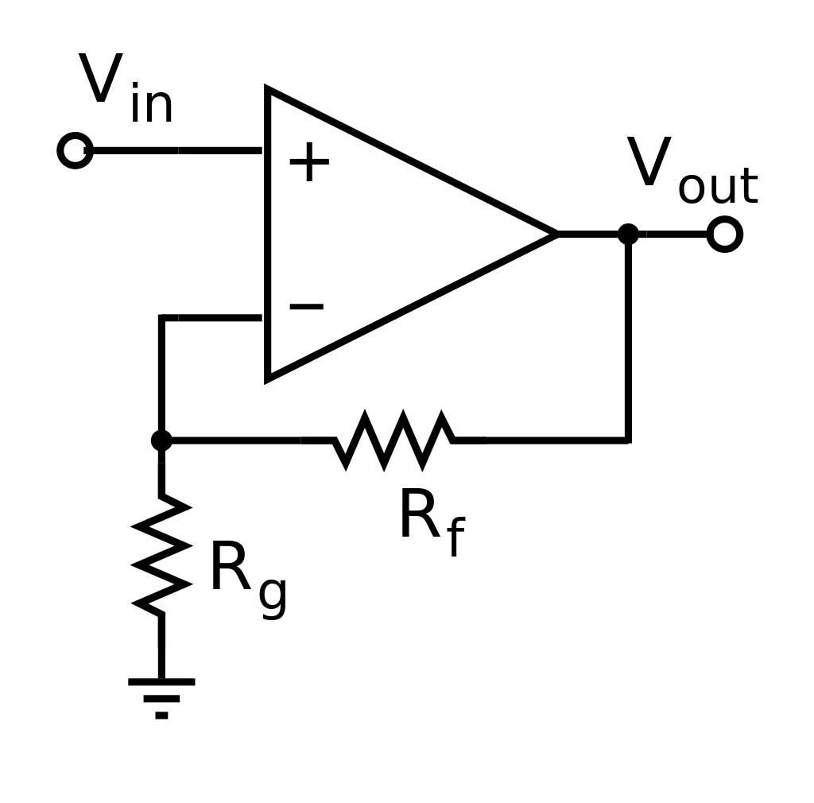
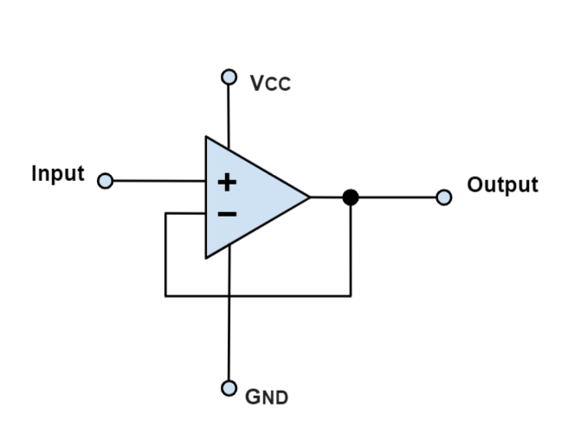
Operational Amplifiers (Op-amps)
Often called the “multi-tool” of analog electronics, the operational amplifier circuit is a combination of resistors and transistors that, in its most basic use case, can act as a current or voltage amplifier. A basic voltage amplifier op-amp circuit is shown on the left; the gain is determined by the ratio of the resistor values.
The ideal op-amp produces Vout proportional to the difference between the voltage V- of its inverting (-) and V+ non-inverting (+) inputs. Any op-amp circuit can be analyzed using Ohm’s and Kirchoff’s laws if the above ideal behavior is considered.
In robotics, op-amps are useful as analog buffers, particularly when dealing with sensitive sensors. For example, a sensor may not be able to provide enough current to supply its measurement voltage over a long cable. A unity-gain buffer circuit (or “voltage follower”) consists of an op-amp with direct feedback (no resistor) from the output to the inverting input. This circuit repeats the voltage from a weak sensor but draws current from the op-amp’s power supply (Vs) to drive a long cable.
In a few slides, we’ll see how op-amps can form the basis of analog-to-digital conversion.
Basic amplifier circuit
Buffer circuit
Source: https://www.monolithicpower.com/en/operational-amplifiers
Source: https://en.wikipedia.org/wiki/Operational_amplifier

Slide 19
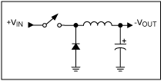
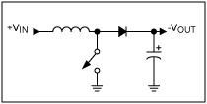
Switching regulators
Buck configuration
Boost configuration
By rapidly switching power on and off to a combination of diode, capacitor, and inductor, a DC voltage can be increased (“boost”) or decreased (“buck”) precisely depending on the switching frequency. The back-EMF from the inductor is rectified by the diode and filtered by the capacitor to produce an output DV voltage.
This is useful for voltage conversion and regulation, and forms the basis for “switch-mode power supplies”.
Source: https://www.maximintegrated.com/en/design/technical-documents/tutorials/2/2031.html

Slide 20
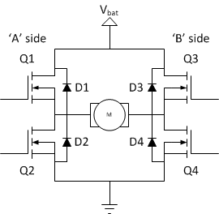
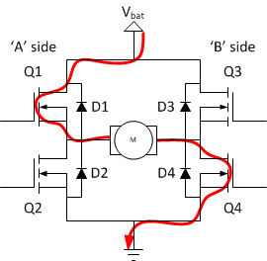
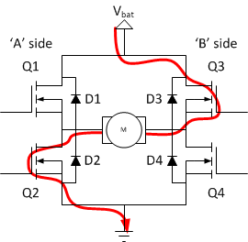
Brushed DC motor bi-directional control: H-bridge
H-bridge
Forward
Reverse
Brushed DC motors can be controlled bi-directionally by a configuration of transistors, typically MOSFETs, known as an ”H-bridge”. A microcontroller controls the gate of each transistor with low-power logic signals, and the transistors switch current through the motor accordingly.
The diodes eliminate the back-EMF from switching the motor current direction, also known as “flyback”. Diodes used for this purpose are known by several colloquial names, such as “snubber diodes”, “freewheeling diodes”, “flyback diodes”, etc.
Source: https://www.instructables.com/Complete-Motor-Guide-for-Robotics/

Slide 21
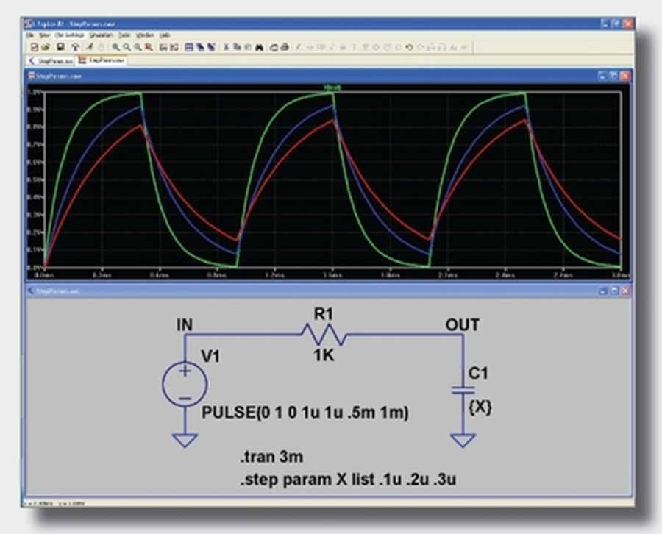
Electrical circuit simulation: SPICE
Complicated, non-linear circuits can be difficult to solve analytically, particularly if transient behavior is considered (i.e. circuit response to a single pulse). Software such as “LTSpice”, which uses the “SPICE” open-source circuit simulation engine engine, can solve such analog and digital circuits and plot any voltage or current as a function of time (see image on the left for an example).
Source: https://www.analog.com/en/design-center/design-tools-and-calculators/ltspice-simulator.html
Source: https://www.analog.com/en/technical-articles/ltspice-using-the-step-command-to-perform-repeated-analysis.html

Slide 22
Digital Electronics Principles

Slide 23
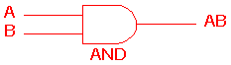
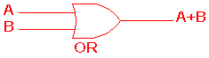
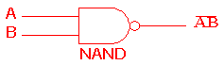
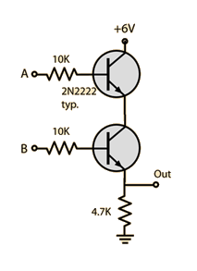
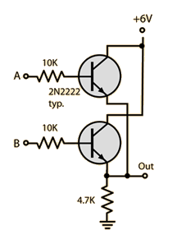
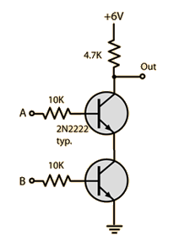
Transistor-Transistor-Logic (TTL)
AND gate
OR gate
NAND gate
So far, we’ve discussed “analog” electronics, where the voltages can be of any value. However, in “digital” electronics, signals are considered to be binary; i.e. there are only two states, ”0” and “1”.
The TTL standard considers 0V (ground) to be “0” (or “low”) and 5V to be “1” (or “high”). There is actually a voltage range for either 0 or 1, shown in the image to the left, to account for less-than-perfect circuit behavior.
The circuits on the left show how to build three simple logic “gates” for manipulating digital inputs. Note that the transistors are biased to be either off or in saturation; the middle amplification section of the V-I curve is avoided in digital circuits.
In A | In B | Out
0 | 0 | 0
0 | 1 | 0
1 | 0 | 0
1 | 1 | 1
In A | In B | Out
0 | 0 | 0
0 | 1 | 1
1 | 0 | 1
1 | 1 | 1
In A | In B | Out
0 | 0 | 1
0 | 1 | 1
1 | 0 | 1
1 | 1 | 0
Source: http://www.ee.surrey.ac.uk/Projects/CAL/digital-logic/gatesfunc/index.html
Source: https://circuitdigest.com/electronic-circuits/designing-and-gate-using-transistors

Slide 24


Comparators
In open-loop configuration (no feedback from Vout to either input), an op-amp acts as a voltage comparator; Vout is proportional to the difference between V2 and V1.
This behavior can be used to compare two analog voltages and output a digital voltage of the result. For example, if V2 is higher than V1, Vout = 5V; otherwise Vout = 0.
This is the foundation of digitization, i.e. the conversion of analog information to digital. Furthermore, circuits can be designed to compare digital inputs as well, to be combined with other logic gates to produce complex behavior.
Source: https://en.wikipedia.org/wiki/Comparator

Slide 25


Analog to Digital Conversion
Using multiple comparators with equally-spaced reference voltage levels, an analog signal can be represented by a series of digital bits. The amplitude resolution of such a digitizer circuit for n available bits is 2^n.
The rate at which the digitizer does this multi-bit sampling is also important. If the sample rate is too low, the digitization can unintentionally represent a lower frequency than the original signal; this is known as “aliasing”. The Nyquist-Shannon Sampling Theorem specifies how to prevent this: the sampling rate must be at least twice the highest expected frequency in the analog signal.
The image on the left shows how insufficient sampling rate (black dots) of an analog signal (red curve) can lead to an erroneous reconstruction at lower frequency.
Source: https://www.electronics-tutorials.ws/combination/analogue-to-digital-converter.html
Source: https://en.wikipedia.org/wiki/Nyquist–Shannon_sampling_theorem

Slide 26

Pulse-width Modulation
To vary the speed of a brushed DC motor, a controller must change the voltage. This is not always easy with a digital microcontroller, but it rapidly can turn the motor on and off at full voltage. The percentage of on vs. off time is known as the “duty cycle”.
Since the motor’s natural resistance and inductance acts as a filter, the changing duty cycle ends up looking like a changing voltage. So by varying the duty cycle, a digital microcontroller can effectively control the speed of a brushed DC motor.
Source: https://learn.sparkfun.com/tutorials/pulse-width-modulation/all

Slide 27



Digital Isolation: Optocouplers
A danger of driving motors with PWM is the flyback voltage from the motor’s inductance. This voltage can exceed a microcontroller’s tolerances, permanently damaging the digital output channel.
To electrically isolate the microcontroller from the high-power motor driving circuit (such as an H-bridge), an optocoupler (or “opto-isolator”) is used. The digital signal from the microcontroller lights an LED, which in turn gates a photo-transistor or photodiode and causes it to conduct.
With the right circuit components on the high-power side of the optocoupler, a digital logic signal is produced on the output that matches the digital input, but with complete electrical isolation in-between, protecting the microcontroller from voltage spikes and noise.
Source: https://en.wikipedia.org/wiki/Opto-isolator

Slide 28


Batteries
Below is a summary of typical robotics battery types and their relative characteristics. Battery choice is a balance of capacity, physical size/weight, current discharge capabilities, maintainability and lifetime, and safety considerations.
Total battery capacity is typically expressed in “amp-hours (Ah)”, and the maximum discharge rate (or equivalently, peak load current) in multiples of “C”. For example, a 10 Ah battery with a peak load current of 2C can provide a maximum current discharge of 20A for 30 minutes.
Source: https://www.epectec.com/batteries/cell-comparison.html/

Slide 29

Robotics resources
MIT Open Courseware 2.12: Introduction to Robotics
Stanford CS223A: Introduction to Robotics
Northwestern University: Modern Robotics: Mechanics, Planning, and Control (free pre-print PDF)
Fermilab Robotics Initiative: https://ad.fnal.gov/robotics/
Thank you for your time!
Source: Boston Dynamics

